Slide 1

Cleaning of Census Dataset
Aibangbee Osagie

Slide 2
Content
Objective
Take A Look
Key Observations
Cleaning Steps
New Features Generated
Descriptive Statistics & Visualization

Slide 3
Objective
Tell how the dataset was cleaned and set up for analysis.
Develop insights from analysis of dataset.
Make an informed decision on investing government resources.

Slide 4
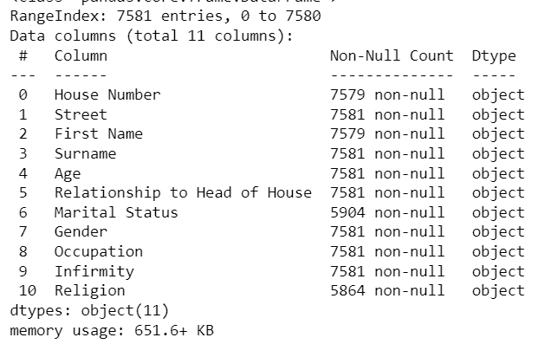
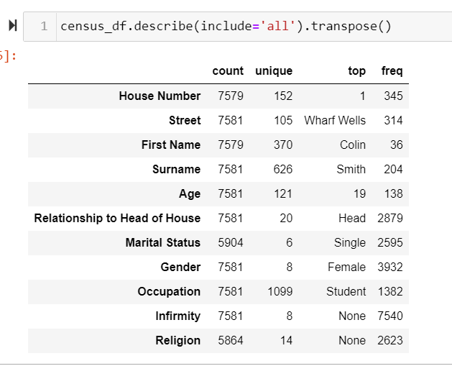
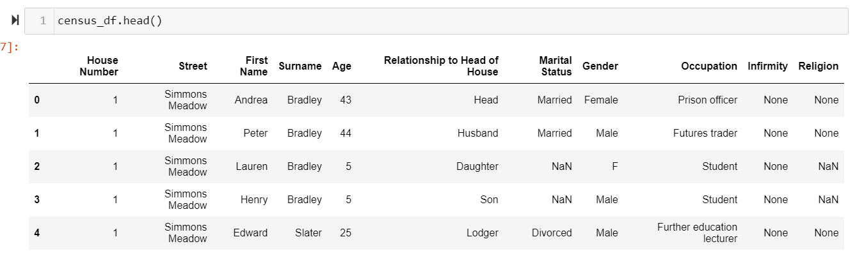
CENSUS DATASET
At first glance:

Slide 5
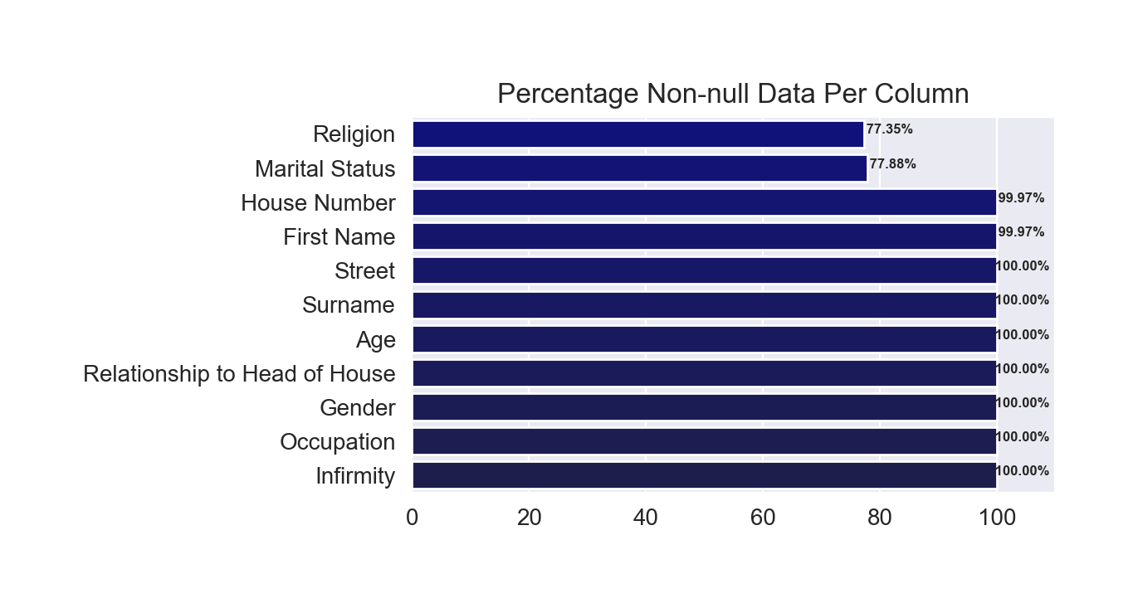
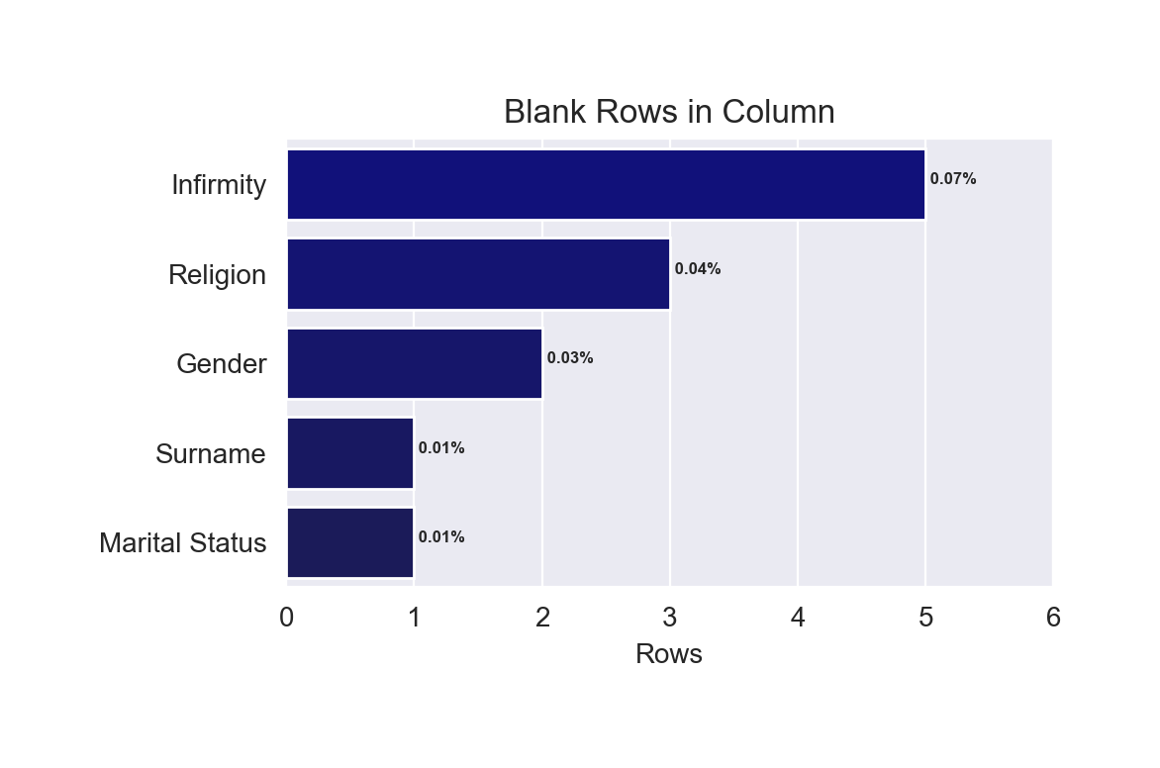
Observations
Data Errors:
Has missing data:
House Number & First Name => 2 null rows each
Marital Status & Religion => 22% is missing data
Contain blanks (as in “ ”):
Surname, Marital Status, Gender, Infirmity & Religion

Slide 6
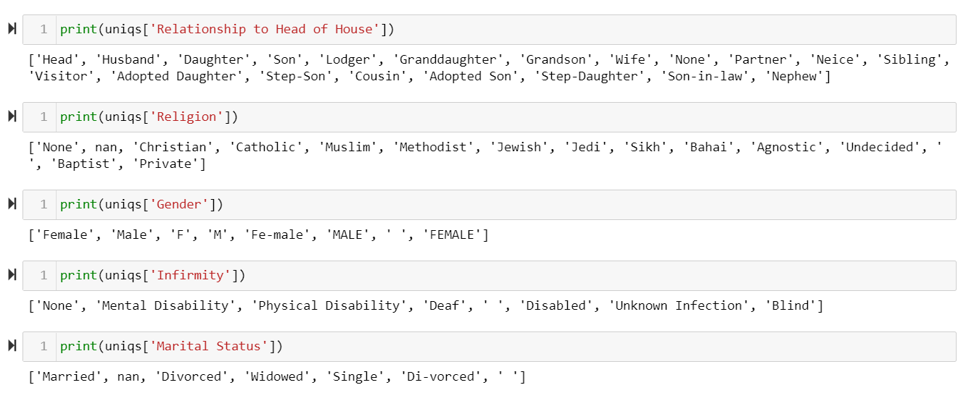
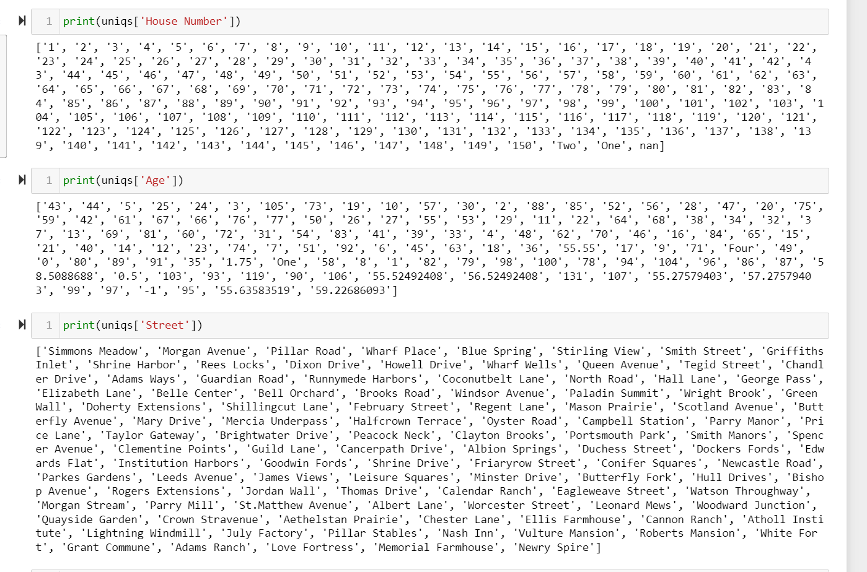
Data Inconsistency
In-between spaces found:
First Name: “Emily Anne” => “Emily-Anne”
Surname: First Names were missing
Redundant categories found:
Religion, Gender, Infirmity, Marital Status
Inappropriate data types found:
Age: “One”, “Four”
House Number: “One”, “Two”

Slide 7
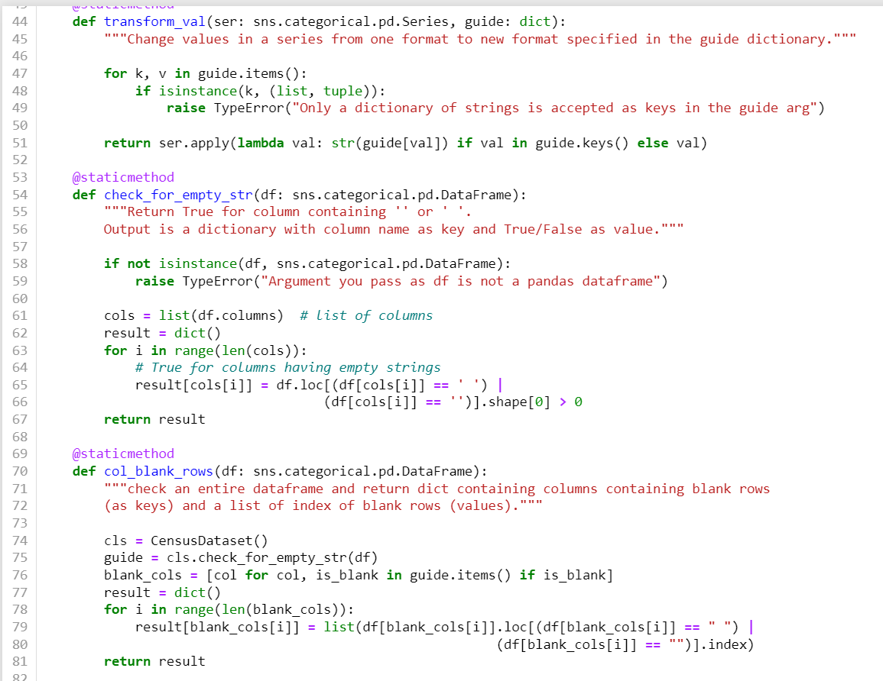
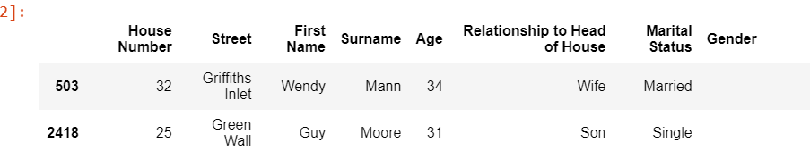
Method of Cleaning
Created a customized module to simplify some tasks.
Imputing blanks:
Using other features to determine blanks or null values:
Relationship to Head of House for blank Gender
Age for Marital Status, Religion
Matching House Number and Street to determine households
Using a subset of residents that match a certain description.
Placeholder for blanks and nulls
Infirmity => “Undisclosed”
Marital Status & Religion => “Ineligible” for minors
Religion => “Unknown”

Slide 8
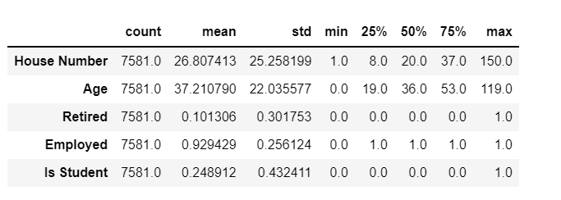
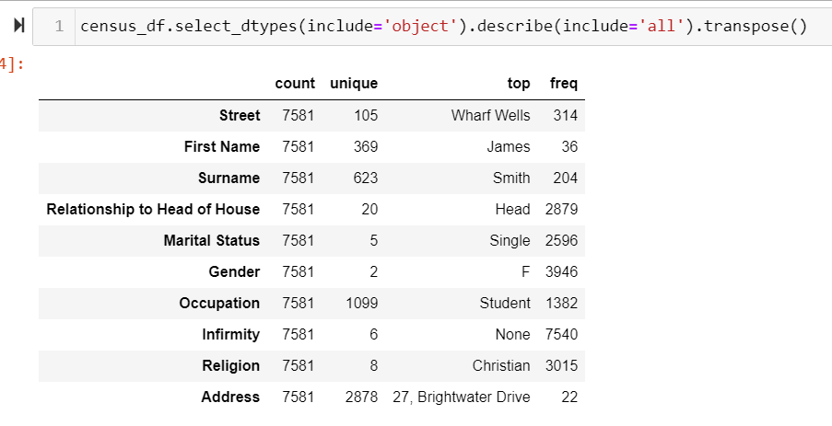
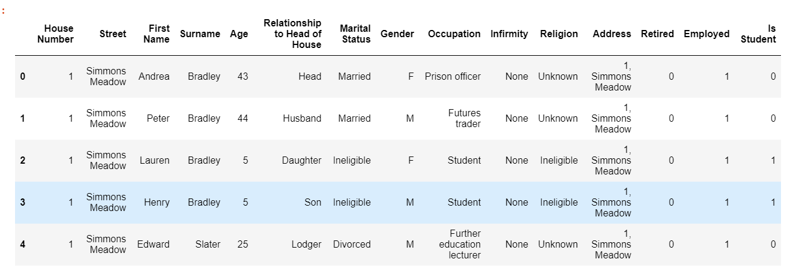
After Cleaning
New features for faster and easier data selection:
Address: combination of House Number & Street (after cleaning)
Retired, Employed, Is Student: Extracted from Occupation

Slide 9
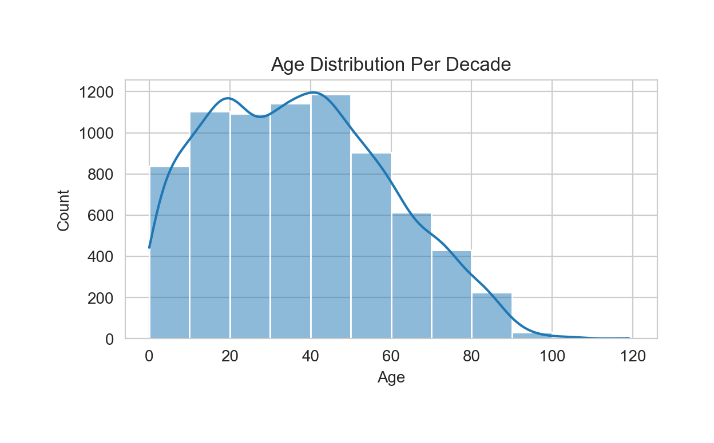
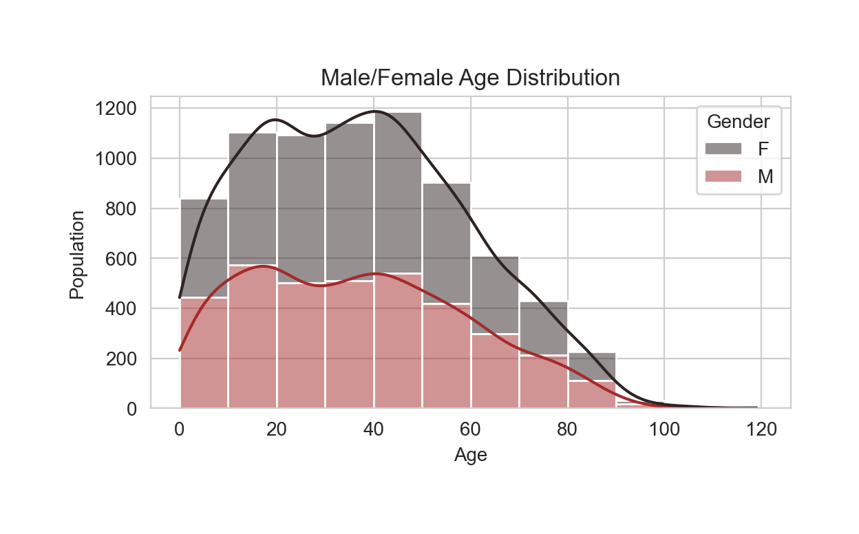
Insights After Cleaning Data
Age Distribution

Slide 10
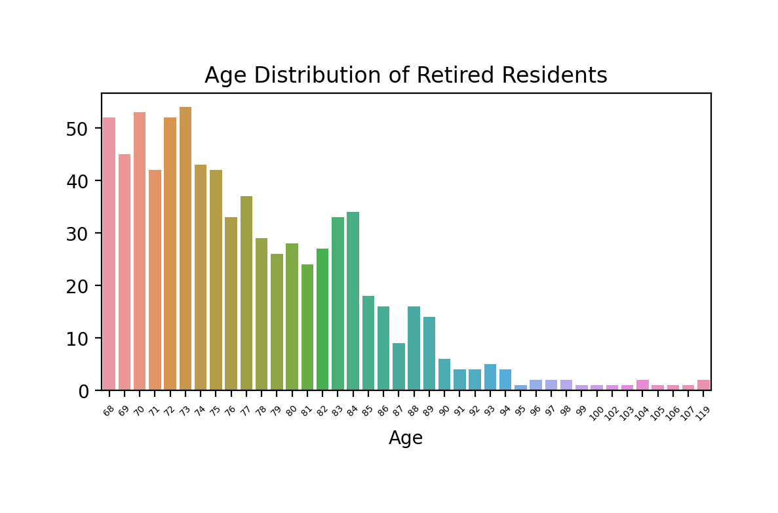
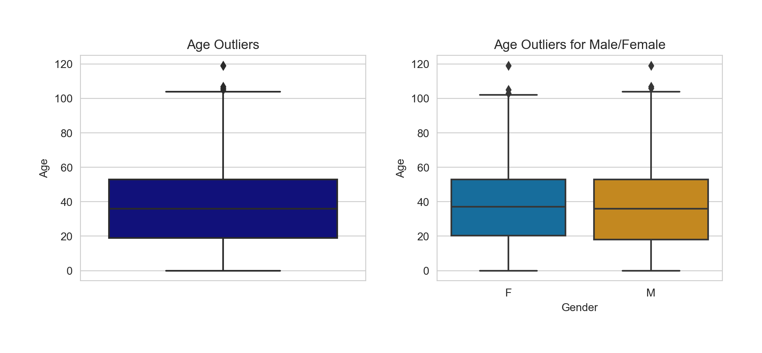
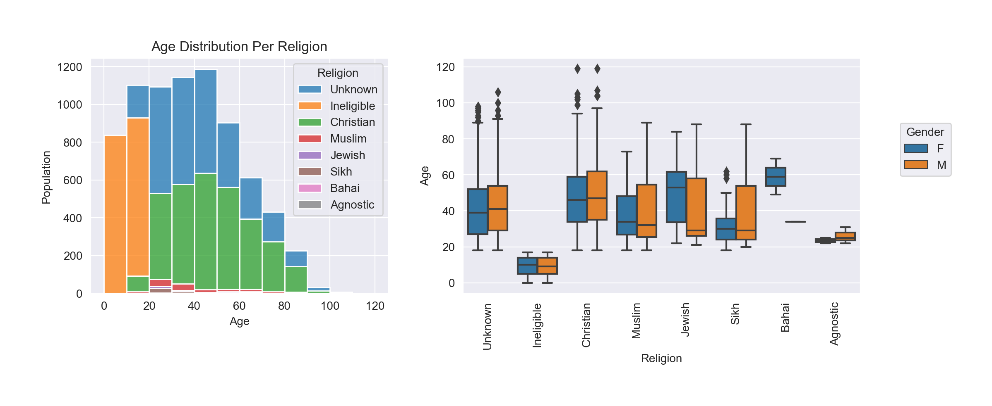
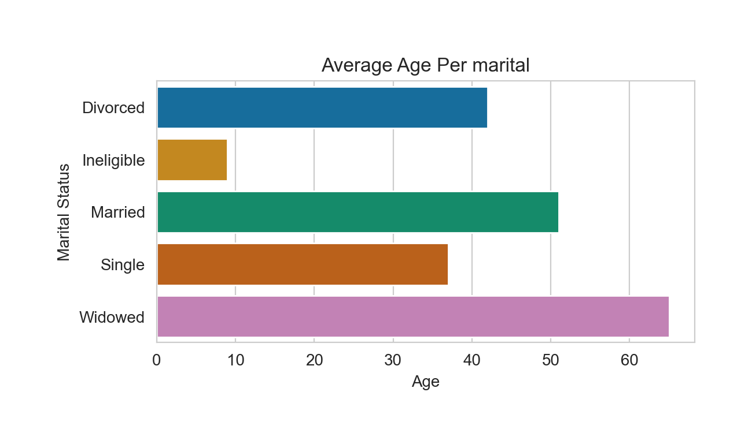
Age Distribution of the Population

Slide 11
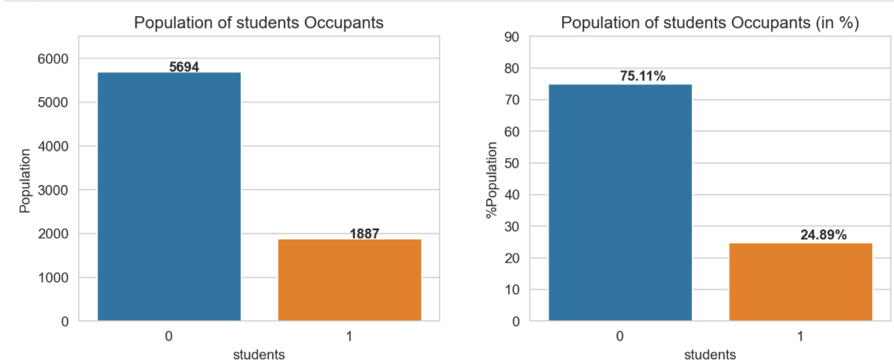
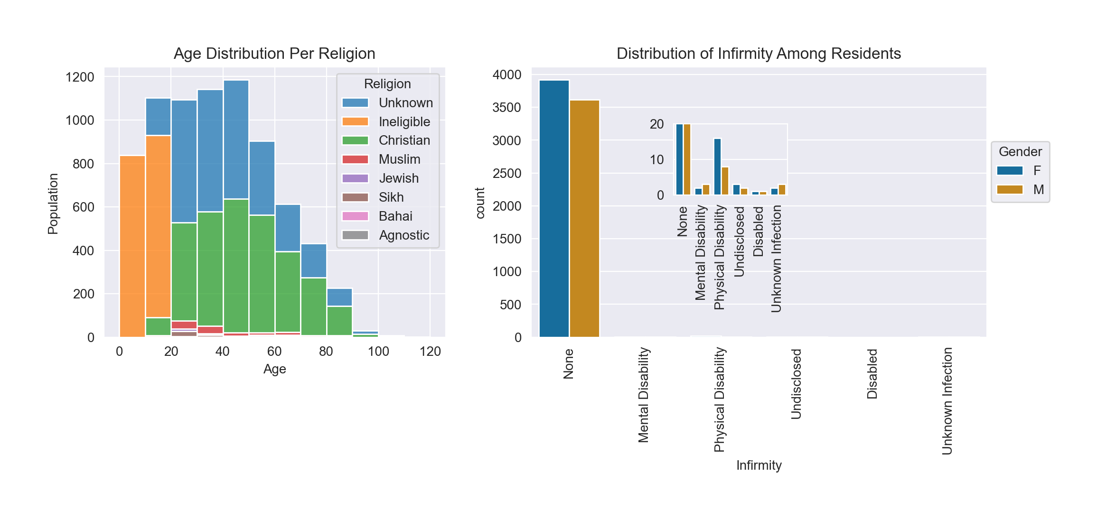
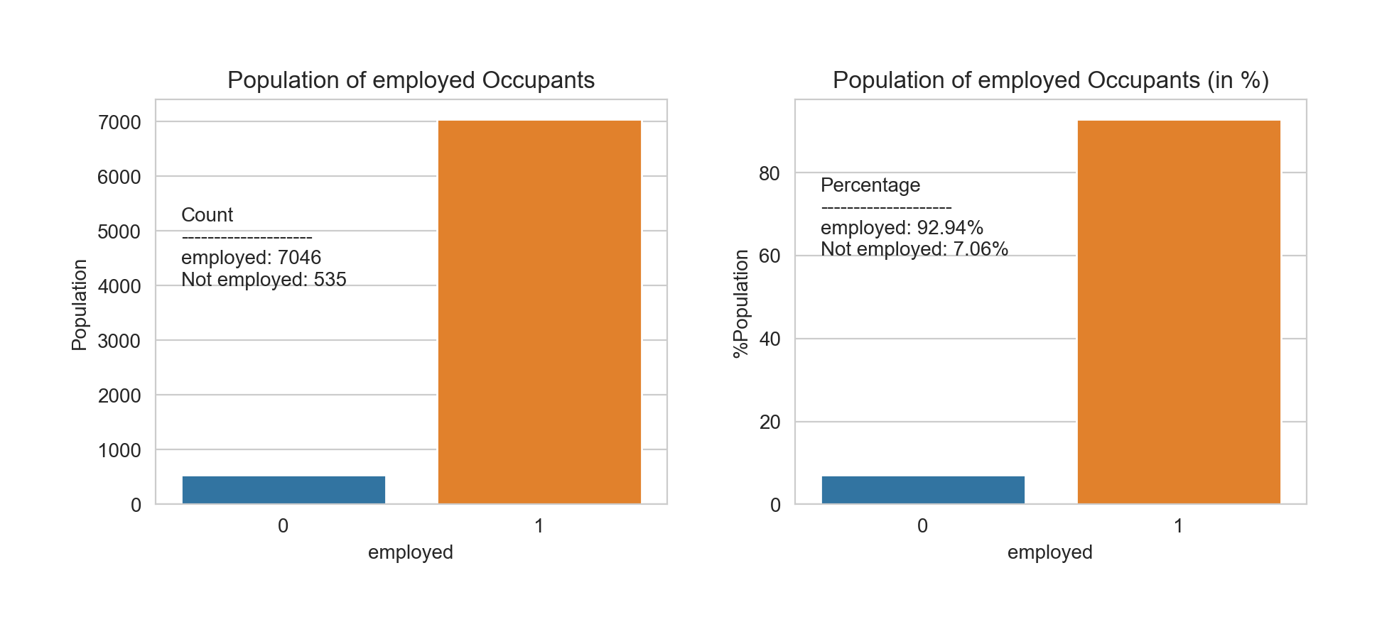
Some Characteristics of the Population

Slide 12
THANK
YOU

